Slide 1

PHISHING DETECTION SYSTEM USING HADOOP AND MACHINE LEARNING
GROUP NUMBER- 15
GROUP MEMBERS:
A.ANNIE GRACE(101601)
TANYA SERAH JACOB(101656)
SWAPNIL MONTERIO(101670)

Slide 2
ROADMAP
1.PROBLEM STATEMENT
2.LITERATURE SURVEY
3.EXISTING SYSTEM
4.PROPOSED SYSTEM
5.S/W & H/W REQUIREMENTS
6.IMPLEMENTATION AND DATASET
7.SNAP SHOT
8.CONCLUSION
9.REFERENCES

Slide 3
PROBLEM STATEMENT
Now a day’s phishing attack has become one of the most serious issues faced by internet users, organizations and service providers. In phishing attack attacker tries to obtain the personal information of the users by using spoofed emails or by using fake websites or both.
The users will be victim for this kind of activities, because phishing web pages looks very similar to real ones, so finds difficult to distinguish between the fake website and ones, detecting this kind of webpage is very difficult because for identification it takes several attributes into consideration which user might not knowing those things.
In this proposed system, Machine learning and Hadoop-Map Reduce is used for fast retrieval of URL attributes, which plays a key role in identifying phishing web pages and it is known for its time efficiency and throughput also can gained using this.

Slide 4
LITERATURE SURVEY
Anti-phishing using Big Data
In this paper, Hadoop-Map Reduce is used for fast retrieval
of URL attributes, which plays a key role in identifying phishing web pages and it is known for its time efficiency and throughput also gained using this.The existing phishing detection systems are highly dependent on database and they are very time consuming also..
2) Analysis and detection of email phishing using pyspark
This system provide robust method to detect phishing Emails which performs some cross-validations techniques. The method includes Text Analysis, Link Analysis to encounter phishing countermeasures. Educational materials reduced users' tendency to enter information into phishing webpages .

Slide 5
LITERATURE SURVEY
3) Phishing Website Detection using Machine Learning : A Review
In this paper Machine Learning is used as an efficient technique to detect phishing. It also removes drawback of existing approach. They perform detailed literature survey and proposed new approach to detect phishing website by features extraction and machine learning algorithm.From this, blacklist approach is commonly used because it is easy to use and implement but it fails to detect new phishing attacks..

Slide 6
EXISTING SYSTEM
IE Phishing Filter:
TYPE: Client Side Tool.
DESCRIPTION: Records specific user website visiting patterns.
ADVANTAGE: Adapts to user's website visit pattern.
DISADVANTAGE:Works only on internet explorer
Snort: TYPE: Network Level
DESCRIPTION: Heuristic/rule engine
Pros:Good at detecting level attacks
Cons: Rules require manual adjustments. Does not look at content.
3) CatchingPhish: TYPE: Client Side Tool
DESCRIPTION: Detects fake website based on rendered images.
Pros: Browser independent. Good results on small data sets.
Cons: Processing time is high. Susceptible to screen resolution.

Slide 7
PROPOSED SYSTEM
1) The user will enter the URL of the webpage, she wishes to visit.
Using that URL, we will download the source code of the webpage &
then decide the values of the attributes.
2) For finding these values we will make use of Hadoop-MapReduce.
This will speed up the process of attribute value assignment. Basic
word count example of Hadoop-MapReduce is used to search
sensitive words in webpages. In same way wherever required help of
Hadoop is taken.
3) These calculated attributes are the input to the Prediction module.
Based on the records stored from phishtank.com database, training
data is prepared.

Slide 8
PROPOSED SYSTEM
4) All the characteristics of reported phishing website at phishtank.com
corpus are studied and based on that attributes are decided and
training data for machine learning algorithm is prepared.
5) Using training data machine learning algorithm generates set of rules
based on which decision is to be made.
6) Prediction module gets two inputs rules generated by machine
learning algorithm and attribute found from requested URL. Prediction
module finally predict URL falls under which category (Phishing,
Legitimate, and Doubtful).

Slide 9
S/W AND H/W REQUIREMENTS:
Software Requirements
1. Windows Operating system version 7 and above
2. Hadoop software (eg. Cloudera Enterprise 6.3)
3. Python version 3.6
4. Machine learning libraries like pandas, sklearn, Theano and numpy.
Hardware Requirements
1. Minimum processor speed of 2.3 GHZ
2. Minimum RAM size 4GB.
3. 500 GB to 1 TB harddisk
4. 802.11 b/g/n wireless network

Slide 10
DESIGN

Slide 11
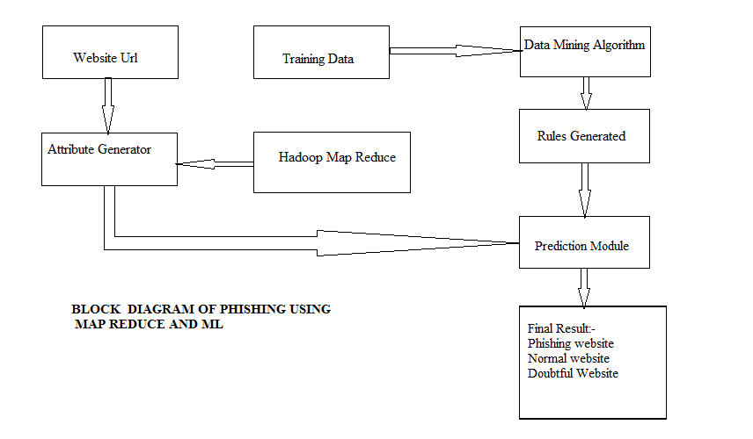
BLOCK DIARGAM

Slide 12
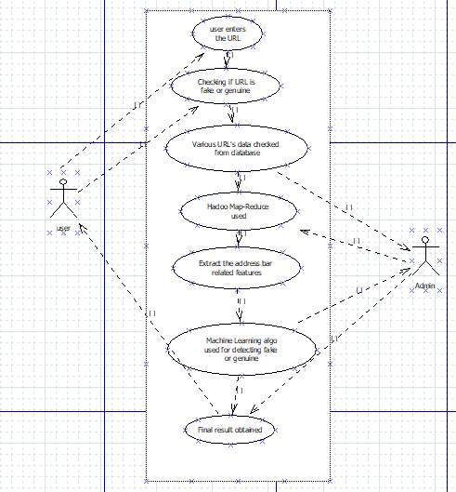
USE CASE DIAGRAM :-

Slide 13
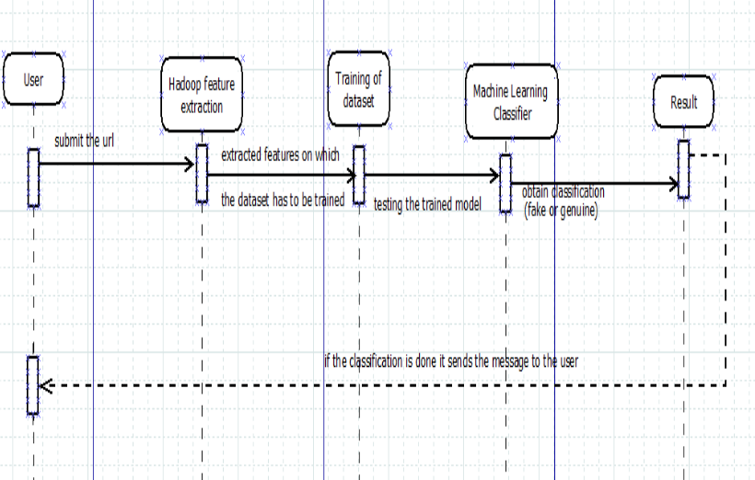
SEQUENCE DIAGRAM

Slide 14
Let’s review some concepts
PYTHON PANDAS:
Pandas is an open-source Python Library providing high-performance data manipulation and analysis tool using its powerful data structures. The name Pandas is derived from the word Panel Data – an Econometrics from Multidimensional data.
Key Features of Pandas Fast and efficient DataFrame object with default and customized indexing.
Reshaping and pivoting of date sets.Columns from a data structure can be deleted or inserted.
Group by data for aggregation and transformations.
High performance merging and jo
ining of data.

Slide 15
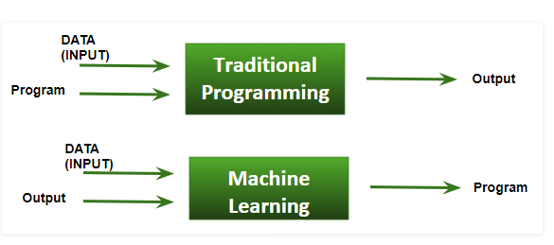
MACHINE LEARNING
Traditional Programming : We feed in DATA (Input) + PROGRAM (logic), run it on machine and get output.
Machine Learning : We feed in DATA(Input) + Output, run it on machine during training and the machine creates its own program(logic), which can be evaluated while testing.

Slide 16
LOGISTIC REGRESSION
Logistic regression, despite its name, is a linear model for classification rather than regression. Logistic regression is also known in the literature as logit regression, maximum-entropy classification (MaxEnt) or the log-linear classifier. In this model, the probabilities describing the possible outcomes of a single trial are modeled using a logistic function.

Slide 17
3. HADOOP
Apache Hadoop is a collection of open-source software utilities that facilitate using a network of many computers to solve problems involving massive amounts of data and computation. It provides a software framework for distributed storage and processing of big data using the MapReduce programming model.

Slide 18
MAP REDUCE
MapReduce is a programming model suitable for processing of huge data. Hadoop is capable of running MapReduce programs written in various languages: Java, Ruby, Python, and C++. MapReduce programs are parallel in nature, thus are very useful for performing large-scale data analysis using multiple machines in the cluster.
MapReduce programs work in two phases:
Map phase
Reduce phase.

Slide 19
4. NUMPY
NumPy is a general-purpose array-processing package. It provides a high-performance multidimensional array object, and tools for working with these arrays.
It is the fundamental package for scientific computing with Python. It contains various features including these important ones:
A powerful N-dimensional array object
Sophisticated (broadcasting) functions
Tools for integrating C/C++ and Fortran code
Useful linear algebra, Fourier transform, and random number capabilities

Slide 20
DATASET
The dataset required for this project has optimized features of phishing website.
The dataset was obtained from PHISHTANK.COM which has 10 columns and is 33KB in size.The dataset is in .csv format.
1.EXPLAINING URL
HAving the phishing Adress
Url Length
Shortening Service
having symbol
double slash redirect in
prefix suffix

Slide 21
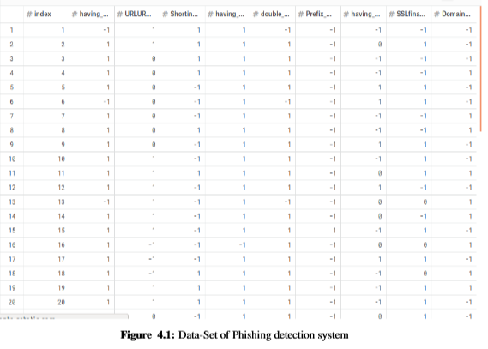

Slide 22
IMPLEMENTATION

Slide 23
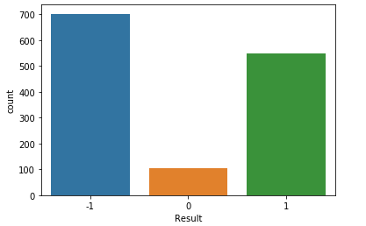
Number of legitimate and phished urls in the dataset

Slide 24
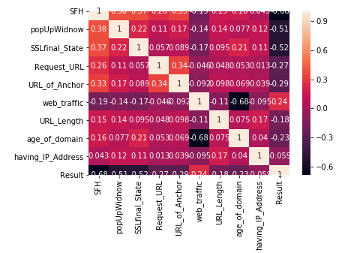
CORELATION MATRIX

Slide 25
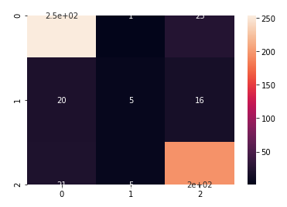
CONFUSION MATRIX

Slide 26
CONCLUSION
Working on this report as a team, we conclude that the Phishing activity has increased posing a serious security threat to computer systems.It is essential to know whether your confidential information is safe and you are not a victim of a phished website.
Till now we have collected the data set on which training and testing and Data Cleaning is done.We are going to extract the features by Hadoop-Map Reduce technique on which training will be done and the website will be categorized as harm or genuine.
We will be using Machine Learning algorithm i.e. SVM(Support Vector Machine) that will help us to classify appropriately the input url as fake or not.

Slide 27
REFERENCES
https://pdfs.semanticscholar.org/515b/2c4b5fe27660d8c29aaf77f7795422a71eaf.pdf
https://pdfs.semanticscholar.org/188f/3bde688d5a47ce86bc0a8eca03aeb1bb9dfc.pdf
https://www.irjet.net/archives/V5/i4/IRJET-V5I4216.pdf
http://ijarcsse.com/Before_August_2017/docs/papers/Volume_3/6_June2013/V3I6-0296.pdf
https://www.researchgate.net/publication/327914514_Web_Phishing_Detection_Using_a_Deep_Learning_Framework/link/5bace23da6fdccd3cb77810e/download

